Slide 1
Welcome to CS4141 PSLG!
With Robert and Jakub

Slide 2

Java for loop
When you know exactly how many times you want to loop through a block of code, use the for loop instead of a while loop.​
Syntax:​
for (statement 1; statement 2; statement 3) {​
// code block to be executed​
}​
Statement 1 (initialization): executed (one time) before the execution of the code block.​
Statement 2 (condition): defines the condition for executing the code block.​
Statement 3 (update): executed (every time) after the code block has been executed.​

Slide 3
Java for loop
Example:​
for (int i = 0; i < 5; i++) {​
System.out.println(i);​
}​
Statement 1 sets a variable before the loop starts (int i = 0).​
Statement 2 defines the condition for the loop to run (i must be less than 5). If the condition is true, the loop will start over again, if it is false, the loop will end.​
Statement 3 increases a value (i++) each time the code block in the loop has been executed.

Slide 4
Problem
Write a Java program to:
Print numbers 1 to n using a for loop.
E.g., 1, 2, 3, 4 …… n.

Slide 5
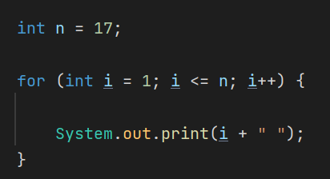
Answer:

Slide 6

Problem
Write a Java program to:
find the value of one number raised to the power of another using a for loop. (Do not use the Java built-in method) E.g., m=2; n=3; result = $m^{n}$ = $2^{3}$ = 8​

Slide 7
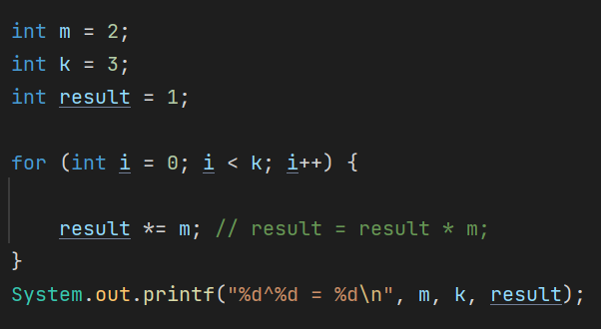
Answer:

Slide 8
Problem
Write a Java program to:
calculate the product of numbers from 1 to n using a for loop.​ E.g., 1*2*3*…*n

Slide 9
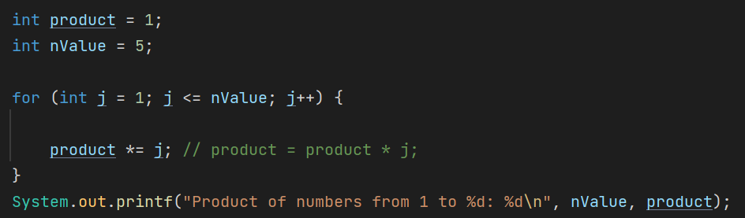
Answer:

Slide 10
Problem
Write a Java program to:
print the sum of all odd numbers from 1 to 50 using a for loop.​ E.g., 1+3+5,+7+9…….45+47+49.

Slide 11
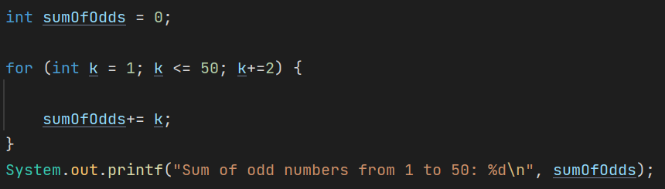
Answer:

Slide 12
Thank you for coming!

